Slide 1
Velvet Dowdy
ESP
Grade 11

Slide 2
Water, Oceans, and Atmosphere
Earth Science

Slide 3
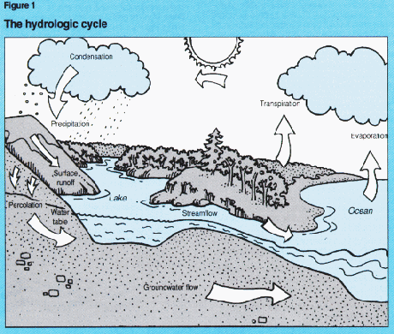

Slide 4
The Hydrologic Cycle
Evaporation
Transpiration
Condensation
Precipitation

Slide 5
The Earth’s Water
97.2% Ocean
2.14% Ice Caps and Glaciers
0.61% Surface Water
0.005% Soil moisture

Slide 6
Earth’s Atmosphere
Earth has an atmosphere for 3 reasons
Volcanic history
Mass of the planet
Amount of radiation from the sun

Slide 7
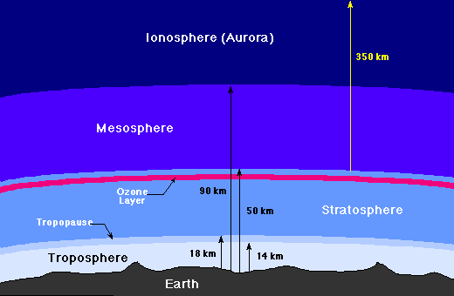

Slide 8
Atmosphere
Troposphere
Stratosphere
Mesosphere
Thermosphere
Ionosphere

Slide 9
90% of our atmosphere is in the troposphere
99% of the atmosphere is below the ozone layer

Slide 10
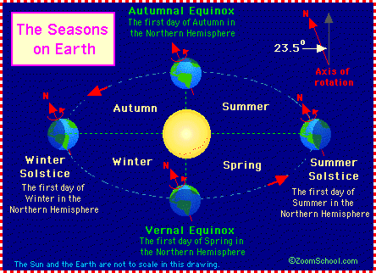

Slide 11
Earth’s Seasons
Any planet that is tilted on its axis will have seasons
As the planet orbits about the sun, the angle at which solar radiation hits areas of the planet will change—hence seasons

Slide 12
Atmospheric Benefits
The surface of the Earth is warmer than it would be in the absence of an atmosphere because it receives energy from two sources: the Sun and the atmosphere.

Slide 13
In the absence of an atmosphere the Earth would average about 30 Celsius degrees (about 50 Fahrenheit degrees) lower than it does at present. Life (as we now know it) could not exist.

Slide 14
The surface of the Earth receives nearly twice as much energy from the atmosphere as it does from the Sun.

Slide 15
The atmosphere radiates because it has a finite temperature, not because it received radiation. When the atmosphere emits radiation, it is not the same radiation as it received from the sun.

Slide 16
Driving forces of Air Motion
Convection Currents
The earth’s rotation

Slide 17
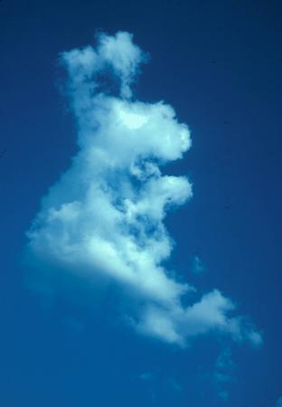
Global Circulation Patterns
Cooler, dense air from the poles pushes warmer, moister, less dense air from the equator upward. This air moves toward the poles and cools.

Slide 18
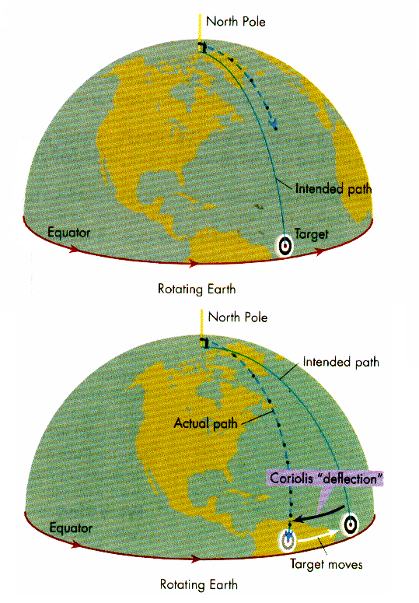

Slide 19
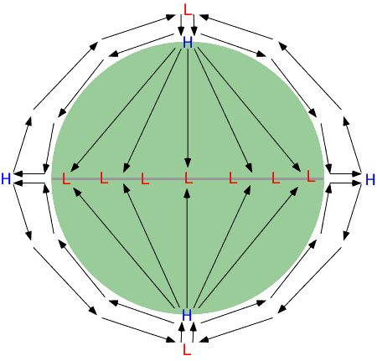

Slide 20
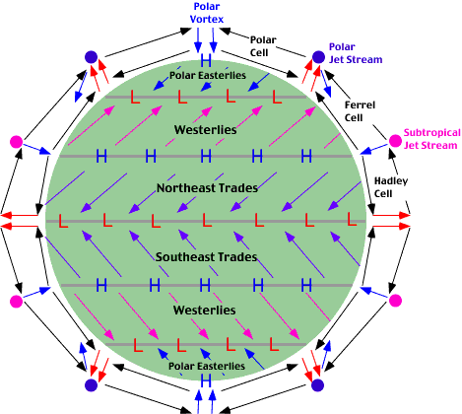

Slide 21
Ocean Currents Affected by
Wind
Density
Earth’s rotation
Earth’s surface and under water features

Slide 22
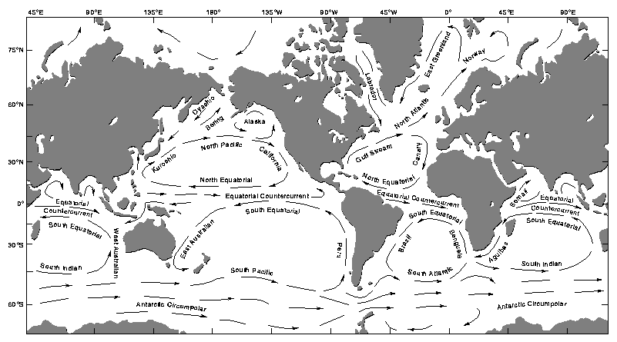

Slide 23
This powerpoint was kindly donated to www.worldofteaching.com
http://www.worldofteaching.com is home to over a thousand powerpoints submitted by teachers. This is a completely free site and requires no registration. Please visit and I hope it will help in your teaching.

